Slide 1
Monday

Slide 2

Hi Owls and Badgers!
Have a pen and paper at the ready, you will need them as you work through my powerpoint!
Can you remember the suffixes we have learnt about?
Write down the ones you can remember!

Slide 3
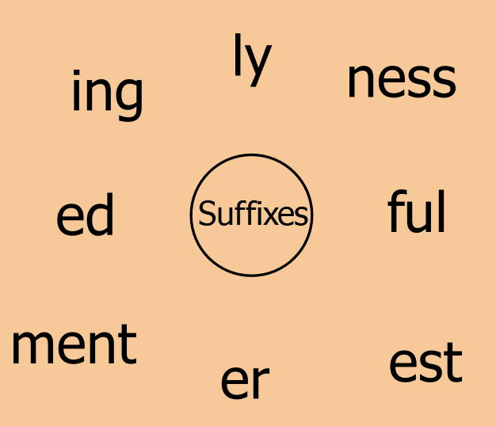
Let’s see if you remembered them
all!

Slide 4

When we add on a suffix we add it to what is called a root word.
For example…..

Slide 5
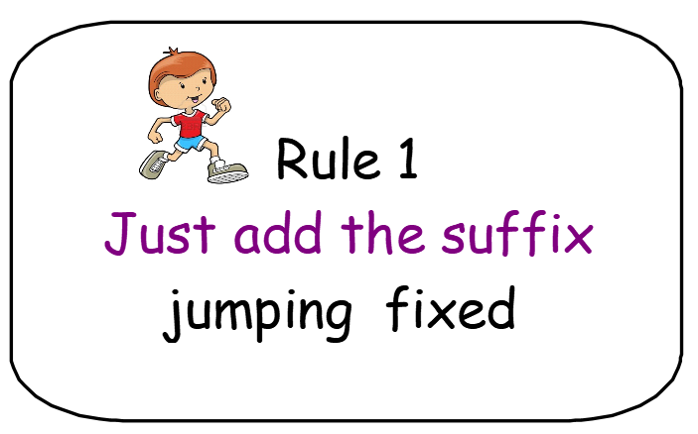
Let’s recap the first two rules we learnt…

Slide 6
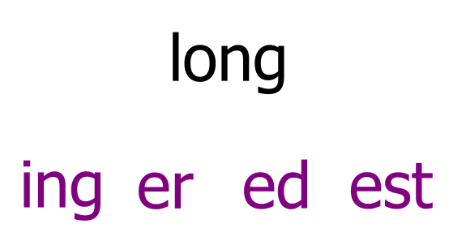
Let’s have a go. On your piece of paper create some new words by adding a suffix.

Slide 7
Did you make these words……..
longer
longest
longed
longing

Slide 8
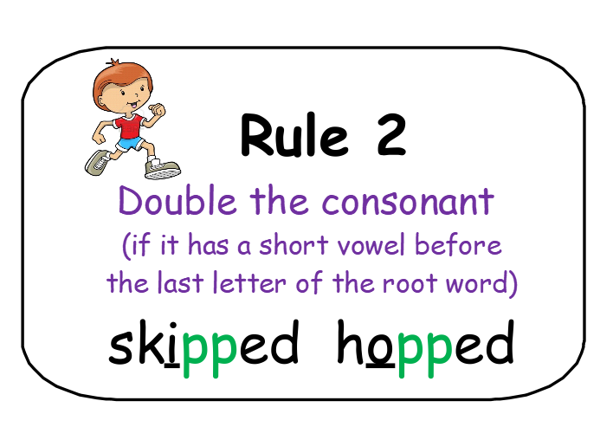

Slide 9
Look at the root word: skip
Can you see the i before the last letter making a short vowel sound?
Now when you add your suffix you double the consonant at the end!
skipping

Slide 10
Look at the root word: jog
Can you see the o before the last letter making a short vowel sound?
Now when you add your suffix you double the consonant at the end!
jogged

Slide 11
On your piece of paper have a go at creating some new words applying rule 2!
run
step
swim
nod
wrap
hot
ing
ed
er
est

Slide 12
Applying both rules together! Look closely at the root word before you add a suitable suffix. Decide which rule you need to apply and write a new word!
joy zip stamp
camp sit loud big
er est ed ing ful ly

Slide 13
Now have a go at the double the consonant see saw activity!

Slide 14
Tuesday

Slide 15
Let’s warm up!
Rule 1 or rule 2?
Write your response on your piece of paper!
camp
stop
ed

Slide 16
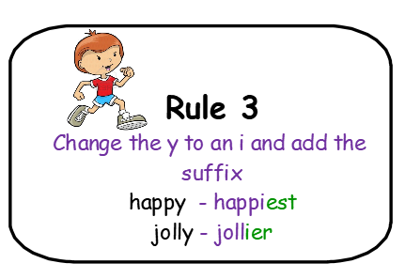
Let’s look at rule 3! It is like our Penny Plural rule!

Slide 17
pretty change the y to an i and add the suffix
prettier

Slide 18
jolly change the y to an i and add the suffix
jolliest

Slide 19
Try some on your piece of paper!
fluffy early bumpy hairy
er est

Slide 20
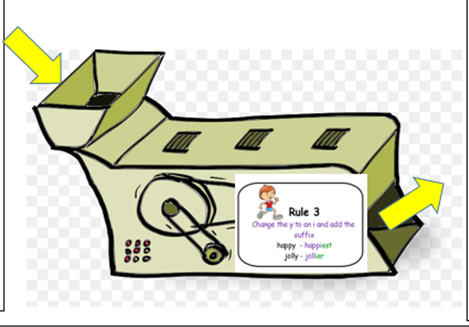
Now try the task attached below the planner!

Slide 21
Thursday

Slide 22
Let’s warm up!
Which rule do you need to apply when you add the suffix? Create three new words on your piece of paper!
step bumpy touch
ed er ing

Slide 23
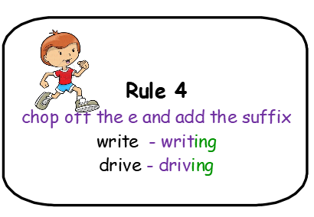
Thursday

Slide 24
make chop off the e then add the suffix
making

Slide 25
change chop off the e then add the suffix
changing

Slide 26
Have a go at applying the rule yourself on your piece of paper. What new words can you make?
strange lunge write drive
er est ed ing

Slide 27
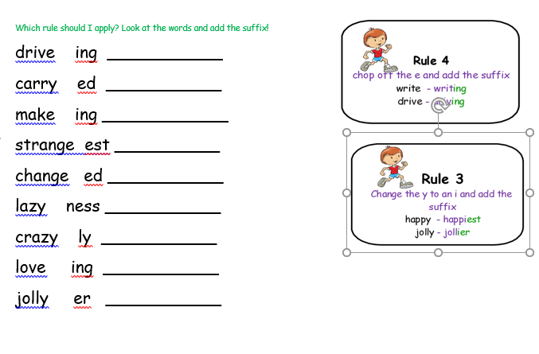

Have a go at the sheet below the planner but watch out! You have to choose whether to apply rule 3
or 4!
Now play the suffix factory game!
https://www.phonicsbloom.com/uk/game/suffix-factory-set-1?phase=6

Slide 28
Friday

Slide 29
Have a go at the challenge sheets attached to the plan! You have to consider all four rules we have learnt!

