Slide 1
Wednesday

Slide 2
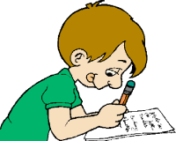
Boards and pens at the ready!

Slide 3
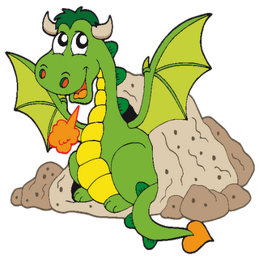
look
say
cover
check
spell

Slide 4
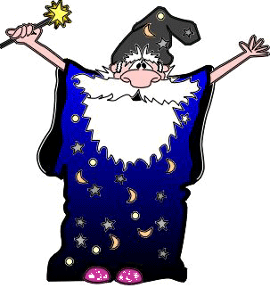
You try!
friend

Slide 5
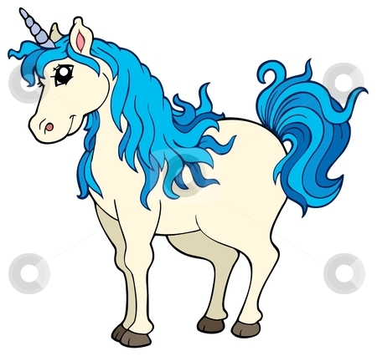
check
friend

Slide 6
Thursday

Slide 7
Boards and pens at the ready!

Slide 8
look
say
cover
check
spell

Slide 9
You try!
children

Slide 10
check
children

Slide 11
Friday

Slide 12
Boards and pens at the ready!

Slide 13
look
say
cover
check
spell

Slide 14
You try!
I’m

Slide 15
check
I’m

