Slide 1
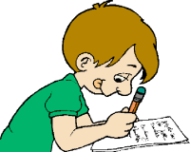
Boards and pens at the ready!

Slide 2
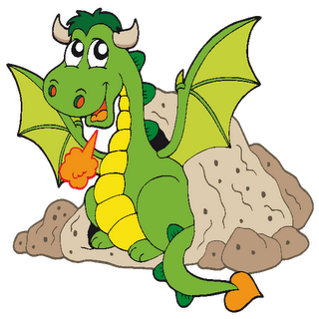
look
say
cover
check
spell

Slide 3
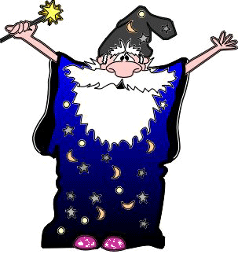
You try!
today

Slide 4
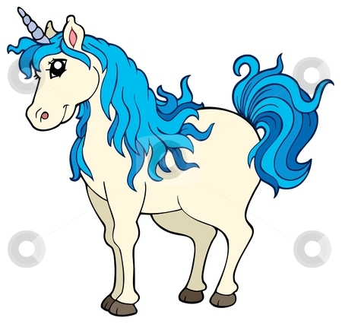
check
today

Slide 5
look
say
cover
check
spell

Slide 6
You try!
asked

Slide 7
check
asked

Slide 8
look
say
cover
check
spell

Slide 9
You try!
find mind

Slide 10
check
find mind

Slide 11
look
say
cover
check
spell

Slide 12
You try!
kind behind

Slide 13
check
kind behind

