Slide 1
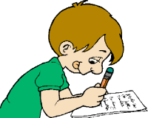
Boards and pens at the ready!

Slide 2
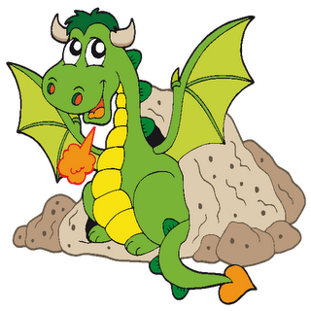
look
say
cover
check
spell

Slide 3
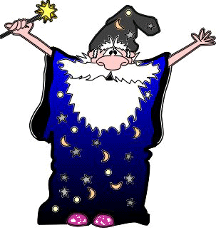
You try!
child wild

Slide 4
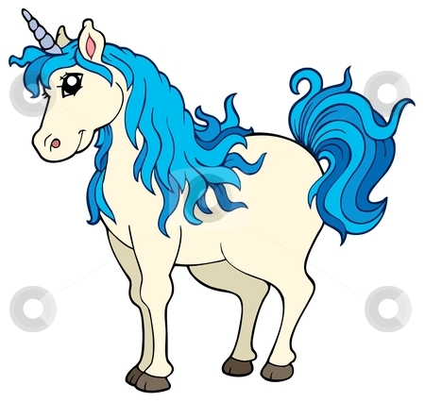
check
child wild

Slide 5
look
say
cover
check
spell

Slide 6
You try!
climb

Slide 7
check
climb

Slide 8
look
say
cover
check
spell

Slide 9
You try!
old cold

Slide 10
check
old cold

Slide 11
look
say
cover
check
spell

Slide 12
You try!
gold cold

Slide 13
check
gold cold

