Slide 1
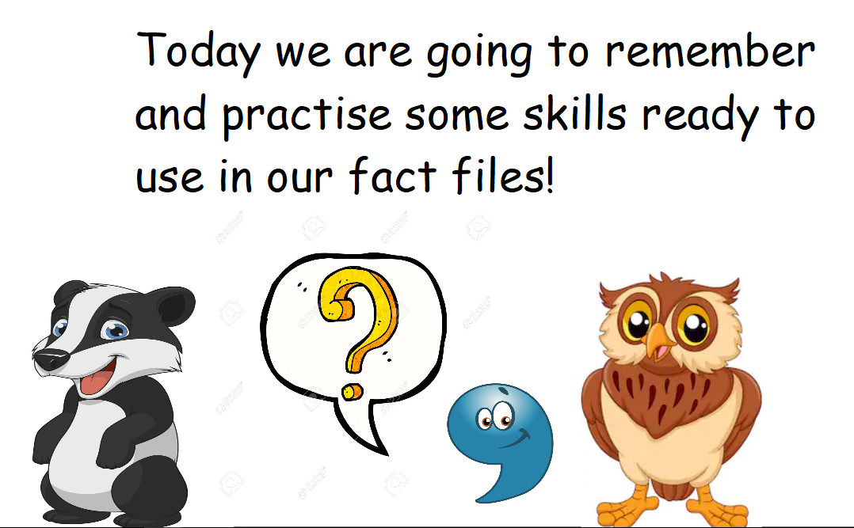

Slide 2
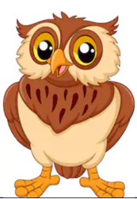
Can you jot down all the words you could start a question with?
Practise recording the shape of a question mark on your paper.
Lets see if we can spot the difference between statements and questions…..

Slide 3
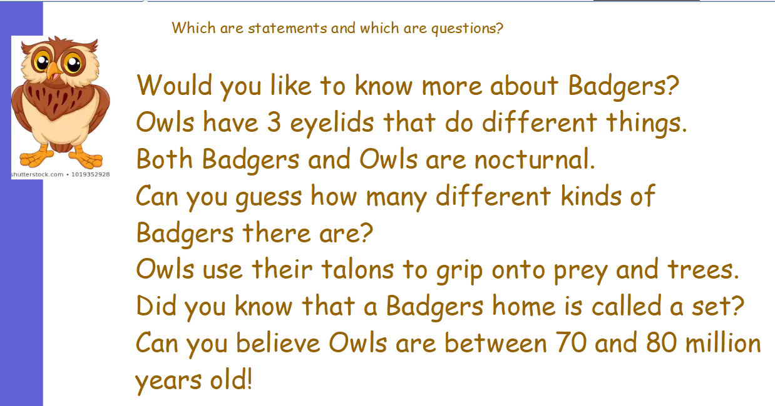

Slide 4
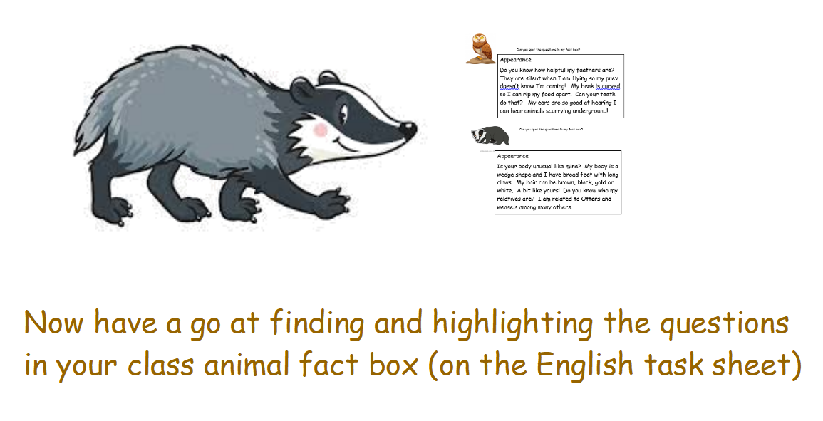

Slide 5
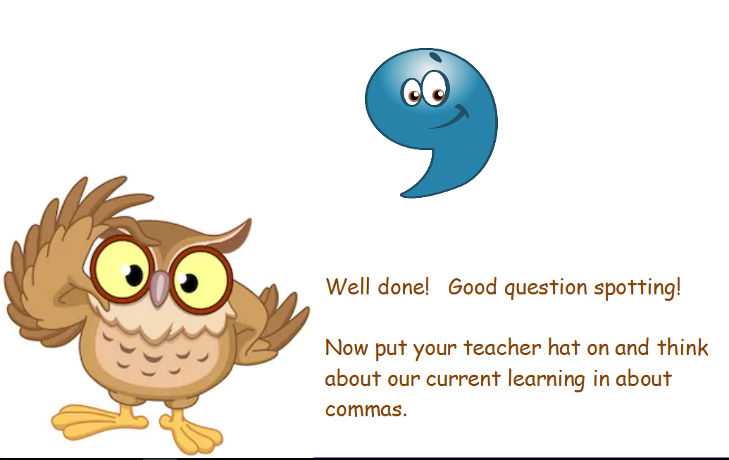

Slide 6
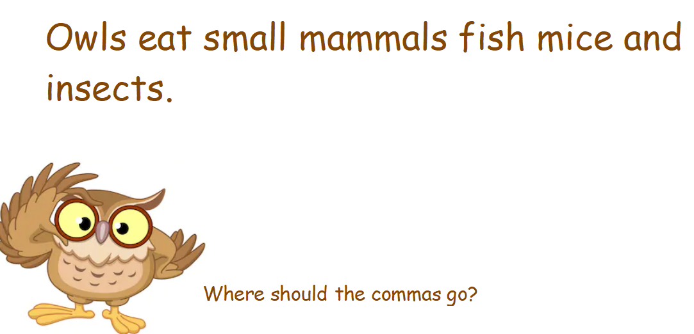

Slide 7
