Slide 1

Get ready to warm-up your
brains!
Monday

Slide 2
Have a look at these spelling words. Read them aloud and copy them down.
Monday Tuesday
Wednesday
Thursday Friday

Slide 3
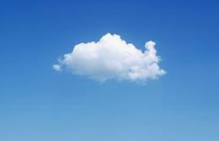
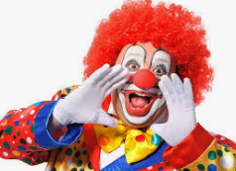
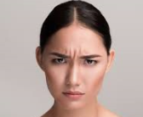
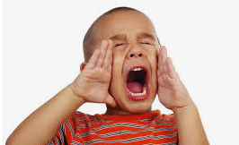
We are looking at the sounds ou and ow this week. Can you remember the rhymes and the best bet rule for these? Why is one sound tricky? Have a go at spelling these!

Slide 4
Get ready to warm-up your brains!
Tuesday

Slide 5
Read the sentence and draw a picture:
Select another activity
The crown was round and it sat in the castle on the clouds.
Label the ow and ou objects in your drawing!

Slide 6
Get ready to warm-up your
brains!
Wednesday

Slide 7

Can you read these sounds and remind your partner of
the rhymes?
ou
ow

Slide 8
Sound button these words to help you read them aloud. Write a sentence using one or more of the words.
pound owl
crown mouse
loud tower

Slide 9
Get ready to warm-up your
brains!
Thursday

Slide 10
Time to practice your spellings! Can you spell the days of the week correctly and in order?

Slide 11
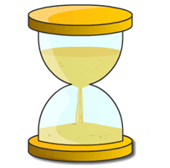
Quick
Write

Slide 12
The town has rain clouds.
The
ow – town
ai – rain
ou - clouds
sensible spaces
.

