Slide 1

ay
stay and play

Slide 2

ey
they are grey

Slide 3

a e
make a cake

Slide 4
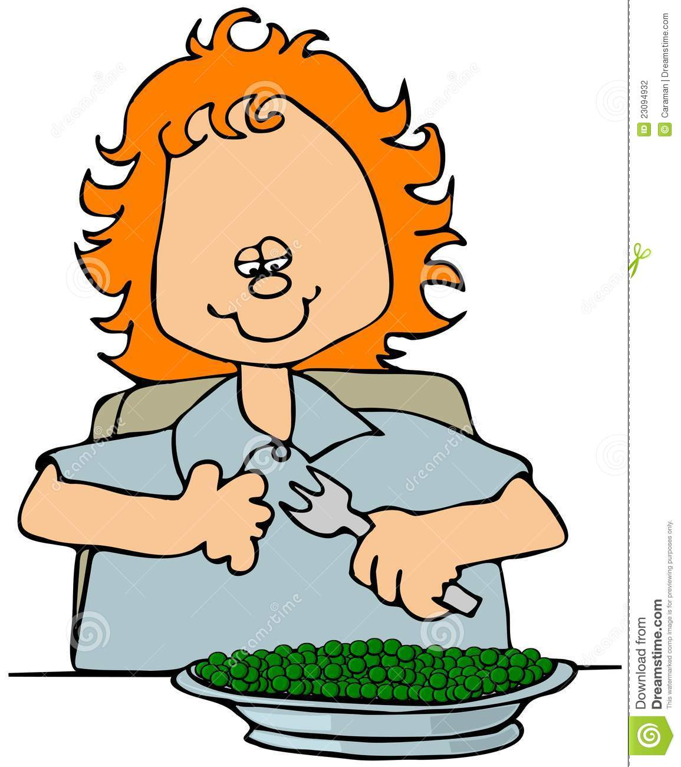
ea
eat your peas

Slide 5

ie
the chief is a thief

Slide 6

e e
these are even

Slide 7
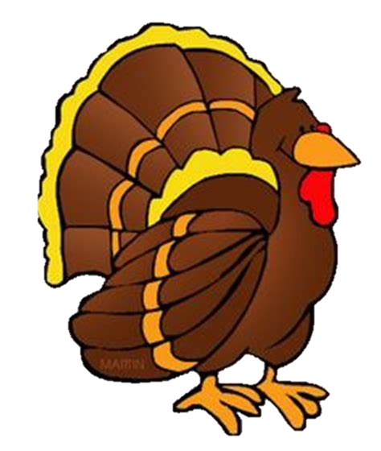

ey
turkey on the chimney

Slide 8
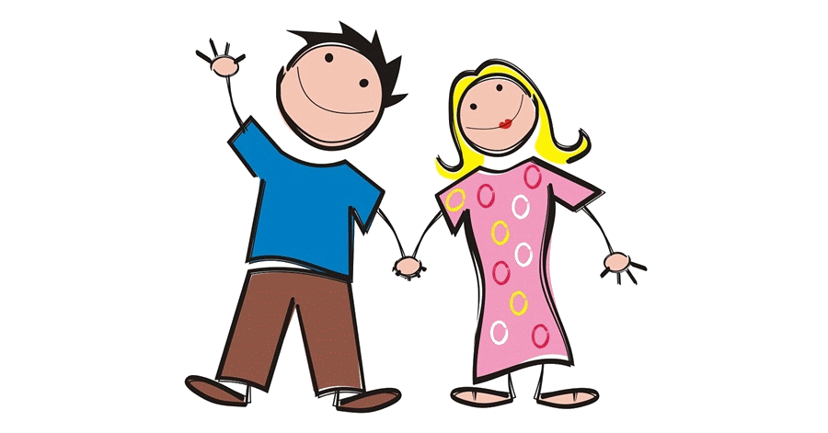
y
Mummy is Funny

Slide 9


ie
tie in my pie

Slide 10

y
there’s a fly nearby

Slide 11

i e
nice smile

Slide 12

ow
blow the snow

Slide 13

oe
I have ten toes

Slide 14
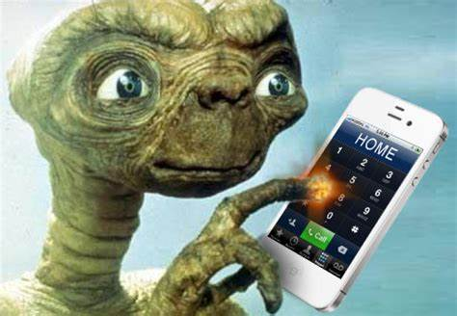
o e
phone home

Slide 15
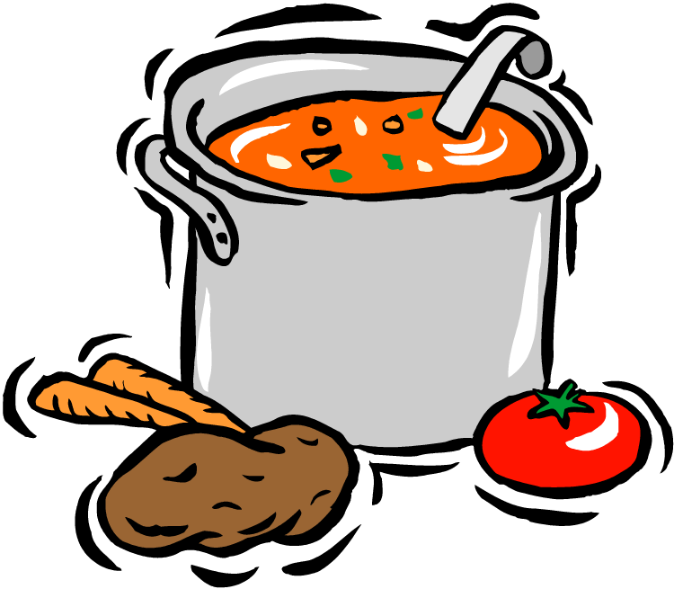
ew
chew the stew

Slide 16
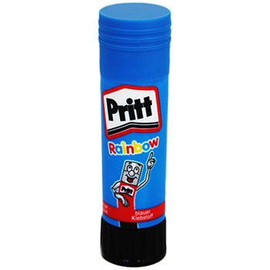
ue
the glue is blue

Slide 17
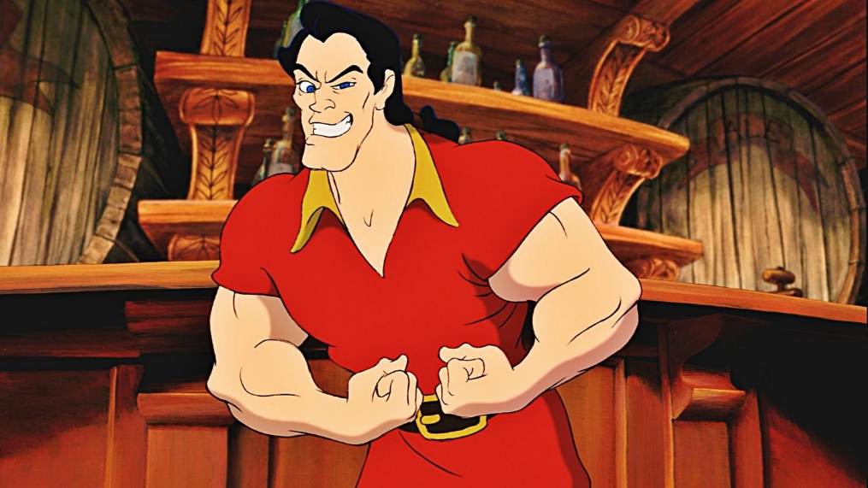
u e
huge brute

Slide 18
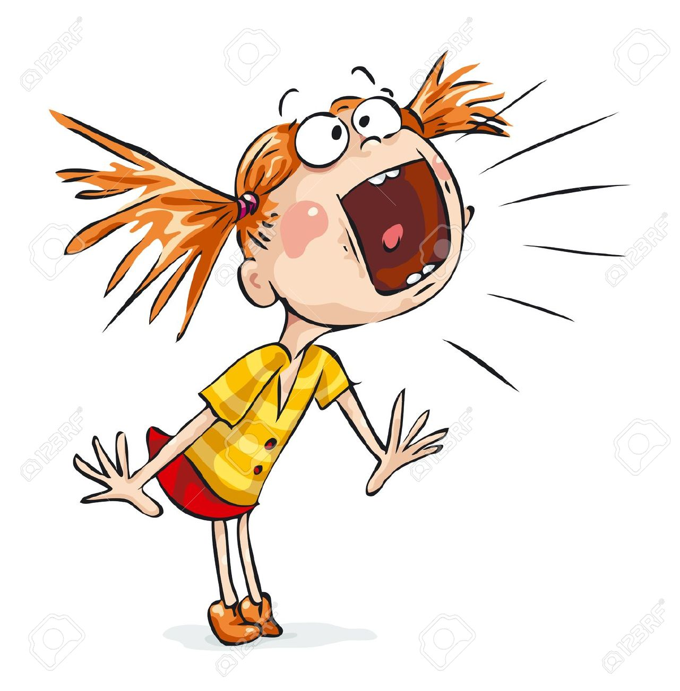
ou
shout out loud

Slide 19
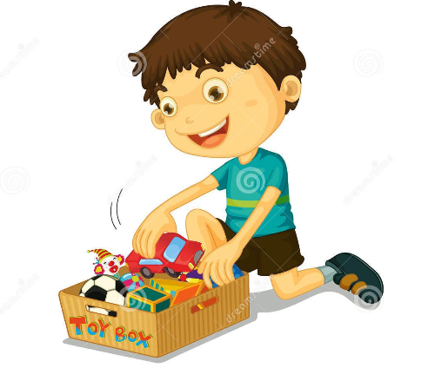
oy
toy for a boy

Slide 20

Could
Should
Would
old unicorns love dozing
z
z
z

